Slide 1

Apache Flink
Stephan Ewen
Flink committer
co-founder / CTO @ data Artisans
@StephanEwen

Slide 2
What is Apache Flink?
A "use-case complete" framework to unify batch & stream processing
Event logs
ETL
Relational
Graph analysis
ML
Streaming aggregations
Flink
Historic data

Slide 3



What is Apache Flink?
An engine that puts equal emphasis on streaming and batch processing
Real-time data
streams
Flink
(master)
ETL, Graphs, Machine Learning Relational, …
Low latency windowing, aggregations, ...
Event logs
Kafka, RabbitMQ, ...
Historic data
HDFS, JDBC, ...

Slide 4
What is Apache Flink?
Large-scale data processing engine
Easy and powerful APIs for batch and real-time streaming analysis (Java / Scala)
Backed by a robust execution backend
with true streaming capabilities,
sophisticated windowing mechanisms,
custom memory manager,
native iteration execution,
and a cost-based optimizer.

Slide 5
Cornerpoints of Flink Design
Flexible Data Streaming Engine
Robust Algorithms on Managed Memory
→ No OutOfMemory Errors
Scales to very large JVMs
Efficient an robust processing
Low Latency Steam Proc.
Highly flexible windows
High-level APIs, beyond key/value pairs
Pipelined Execution of Batch Programs
Java/Scala/Python (upcoming)
Relational-style optimizer
Better shuffle performance
Scales to very large groups
Active Library Development
Native Iterations
Graphs / Machine Learning
Streaming ML (coming)
Very fast Graph Processing
Stateful Iterations for ML

Slide 6
Technology inside Flink
Technology inspired by compilers + MPP databases + distributed systems
For ease of use, reliable performance, and scalability
Data serialization stack
Out-of-core algos
Memory manager
Pre-flight
(client)
Master
Streaming network stack
case class Path (from: Long, to: Long)
val tc = edges.iterate(10) {
paths: DataSet[Path] =>
val next = paths
.join(edges)
.where("to")
.equalTo("from") {
(path, edge) =>
Path(path.from, edge.to)
}
.union(paths)
.distinct()
next
}
Type extraction stack
Recovery metadata
real-time
streaming
Cost-based optimizer
Task scheduling
Workers
...

Slide 7

What can you do with Flink?

Slide 8
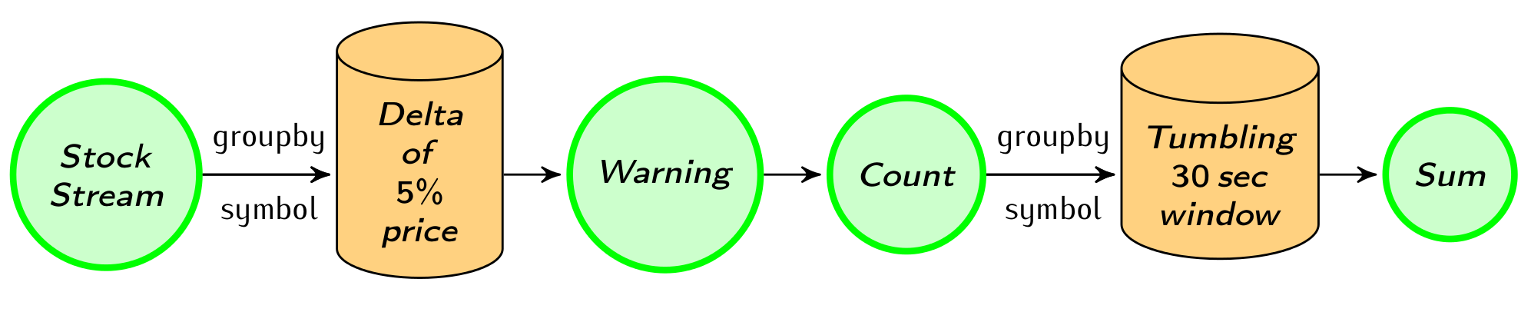
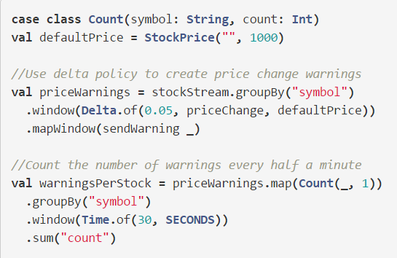
Streaming Data Analysis
More at: http://flink.apache.org/news/2015/02/09/streaming-example.html

Slide 9
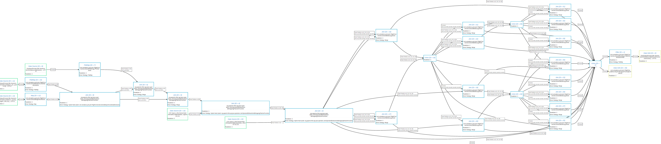
Heavy Data Pipelines
Complex ETL programs
… without memory tuning

Slide 10
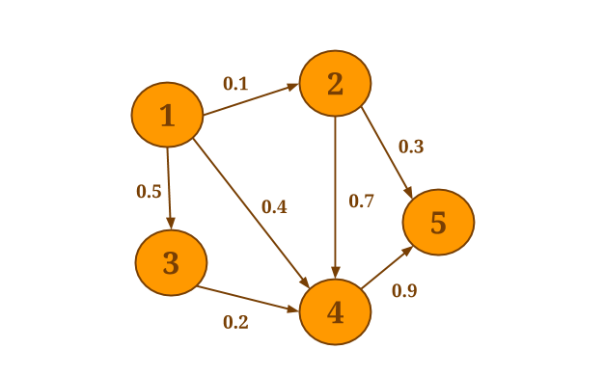
Very fast graph analysis
… and mix and match ETL-style and graph analysis in one program
Performance competitive with dedicated graph analysis systems
More at: http://data-artisans.com/data-analysis-with-flink.html

Slide 11
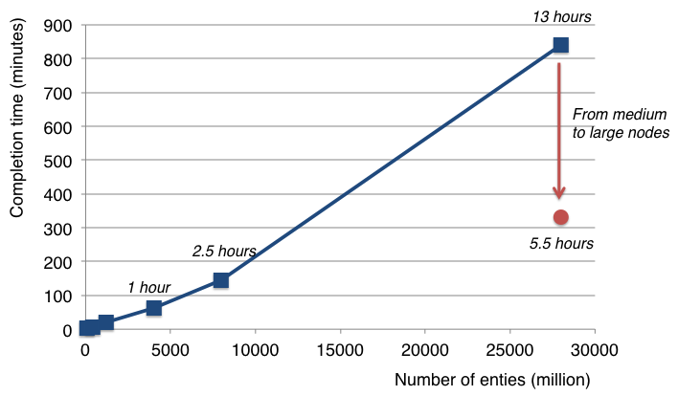
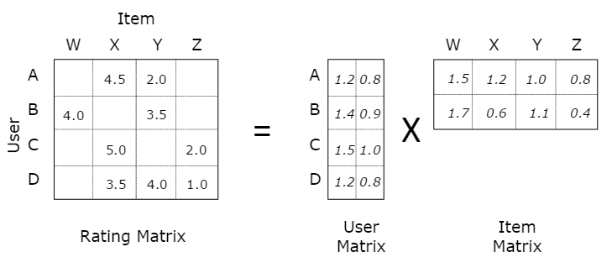
Large-Scale Machine Learning
Factorizing a matrix with 28 billion ratings for recommendations
(Scale of Netflix or Spotify)
More at: http://data-artisans.com/computing-recommendations-with-flink.html

Slide 12
How do you use Flink?

Slide 13
Example: WordCount
case class Word (word: String, frequency: Int)
val env = ExecutionEnvironment.getExecutionEnvironment()
val lines = env.readTextFile(...)
lines
.flatMap {line => line.split(" ").map(word => Word(word,1))}
.groupBy("word").sum("frequency”)
.print()
env.execute()
Flink has mirrored Java and Scala APIs that offer the same functionality, including by-name addressing.

Slide 14
Example: Window WordCount
case class Word (word: String, frequency: Int)
val env = StreamExecutionEnvironment.getExecutionEnvironment()
val lines = env.fromSocketStream(...)
lines
.flatMap {line => line.split(" ").map(word => Word(word,1))}
.window(Count.of(100)).every(Count.of(10))
.groupBy("word").sum("frequency").print()
env.execute()

Slide 15
Flink API in a Nutshell
map, flatMap, filter, groupBy, reduce, reduceGroup, aggregate, join, coGroup, cross, project, distinct, union, iterate, iterateDelta, ...
All Hadoop input formats are supported
API similar for data sets and data streams with slightly different operator semantics
Window functions for data streams
Counters, accumulators, and broadcast variables

Slide 16
Defining windows
Trigger policy
When to trigger the computation on current window
Eviction policy
When data points should leave the window
Defines window width/size
E.g., count-based policy
evict when #elements > n
start a new window every n-th element
Built-in: Count, Time, Delta policies

Slide 17
Table API
val customers = envreadCsvFile(…).as('id, 'mktSegment)
.filter( 'mktSegment === "AUTOMOBILE" )
val orders = env.readCsvFile(…)
.filter( o => dateFormat.parse(o.orderDate).before(date) )
.as('orderId, 'custId, 'orderDate, 'shipPrio)
val items = orders
.join(customers).where('custId === 'id)
.join(lineitems).where('orderId === 'id)
.select('orderId,'orderDate,'shipPrio,
'extdPrice * (Literal(1.0f) - 'discount) as 'revenue)
val result = items
.groupBy('orderId, 'orderDate, 'shipPrio)
.select('orderId, 'revenue.sum, 'orderDate, 'shipPrio)

Slide 18
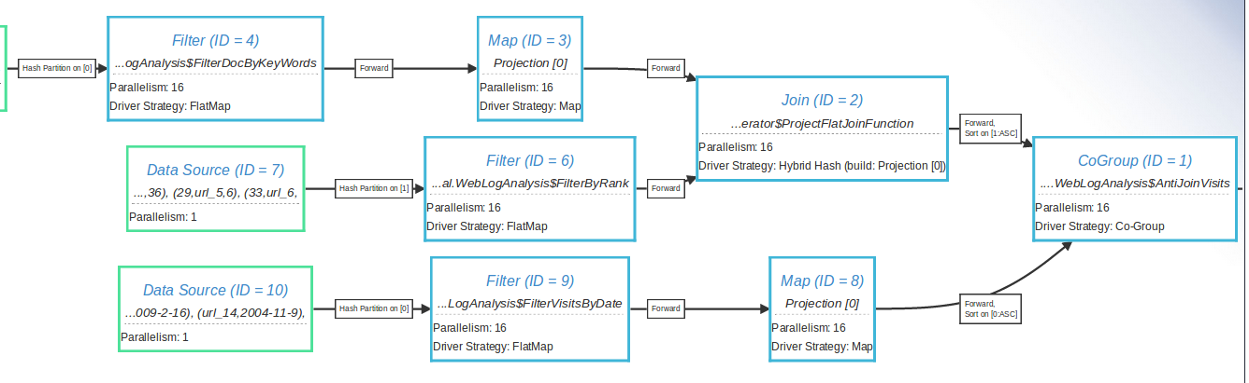
Visualization tools

Slide 19
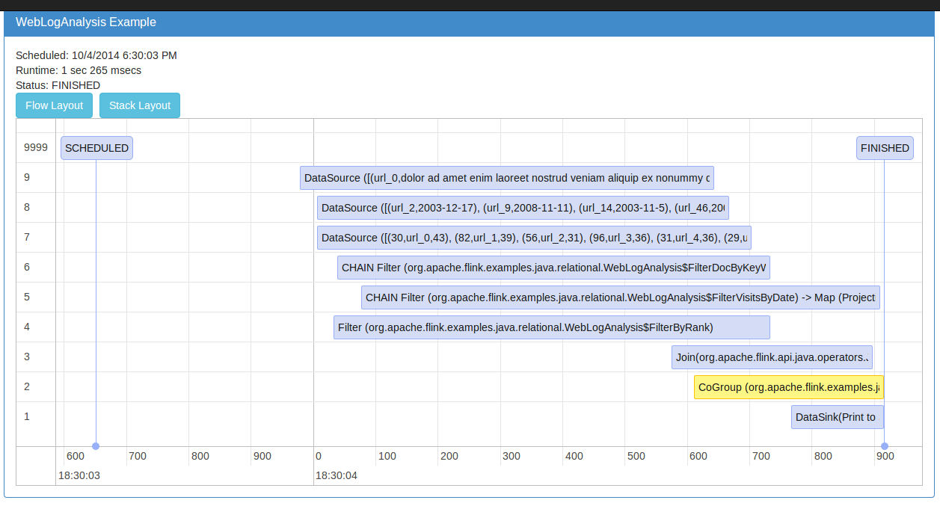
Visualization tools

Slide 20
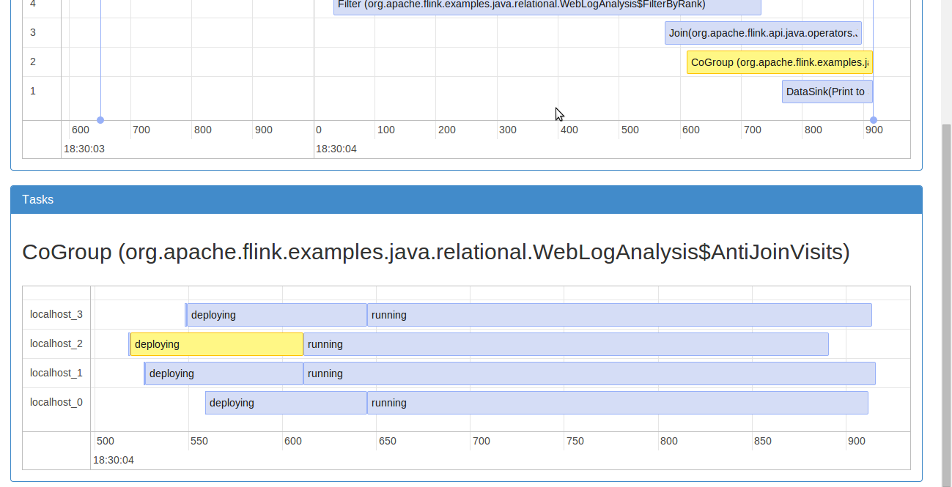
Visualization tools

Slide 21
Flink Architecture

Slide 22
The case for Apache Flink
Performance and ease of use
Exploits in-memory and pipelining, language-embedded logical APIs
Unified batch and real streaming
Batch and Stream APIs on top of a streaming engine
A runtime that "just works" without tuning
C++ style memory management inside the JVM
Predictable and dependable execution
Bird’s-eye view of what runs and how, and what failed and why

Slide 23
Flink stack
Graph API
(Gelly)
Machine Learning
Python API
(upcoming)
Streaming ML (SAMOA) (upcoming)
Apache
MRQL
Java & Scala API
Embedded
Environment
(Java collections)
Flink Optimizer
Flink Stream Builder
Flink Runtime Operators
Local
Environment
(for debugging)
Remote Environment
(Cluster execution)
Apache Tez
Single node execution
Standalone or YARN cluster
Data
storage
Files
HDFS
S3
JDBC
HBase
Kafka
Rabbit MQ
Flume
…

Slide 24




Evolution of Architectures
Operator-centric (MapReduce / DAGs)
Operators and DataSets
Dataset-centric
(RDDs)

Slide 25


Staged (batch) execution
Subseqent stages:
Grep log for matches
Stage 1:
Create/cache Log
Search for str1
Grep 1
Romeo, Romeo, where art thou Romeo?
Load
Log
Search for str2
Grep 2
Search for str3
Grep 3
Caching in-memory and disk if needed

Slide 26
Pipelined execution
Stage 1:
Deploy and start operators
Note: Log DataSet is never “created”!
Search for str1
Grep 1
Romeo, Romeo, where art thou Romeo?
00110011
00110011
00110011
Load
Log
Search for str2
Grep 2
Search for str3
Grep 3
Data transfer in-memory and disk if needed

Slide 27
Pipelining in Flink
Currently the default mode of operation
Much better performance in many cases – no need to materialize large data sets
Supports both batch and real-time streaming
Currently evolving into a hybrid engine
Batch will use combination of blocking and pipelining
Streaming will use pipelining
Interactive will use blocking

Slide 28
Memory management

Slide 29
Memory management in Flink
Flink contains its own memory management stack. Memory is allocated, de-allocated, and used strictly using an internal buffer pool implementation. To do that, Flink contains its own type extraction and serialization components.
User code objects
Unmanaged
public class WC {
public String word;
public int count;
}
Sorting, hashing, caching
empty
page
Managed
Shuffling, broadcasts
Pool of Memory Pages
More at: https://cwiki.apache.org/confluence/pages/viewpage.action?pageId=53741525

Slide 30
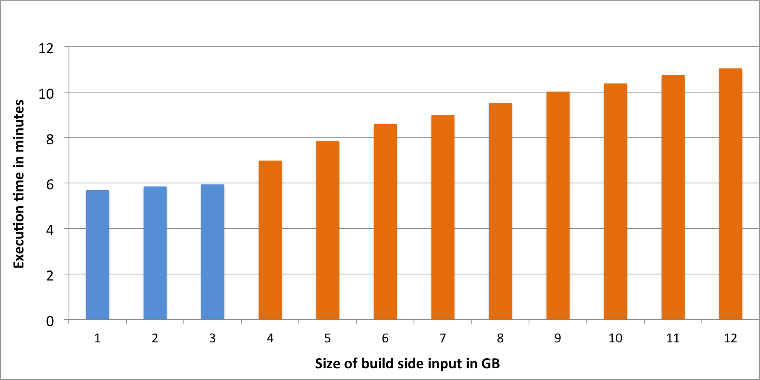
Smooth out-of-core performance
Single-core join of large Java objects beyond memory (4 GB)
Blue bars are in-memory, orange bars (partially) out-of-core
More at: http://flink.apache.org/news/2015/03/13/peeking-into-Apache-Flinks-Engine-Room.html

Slide 31
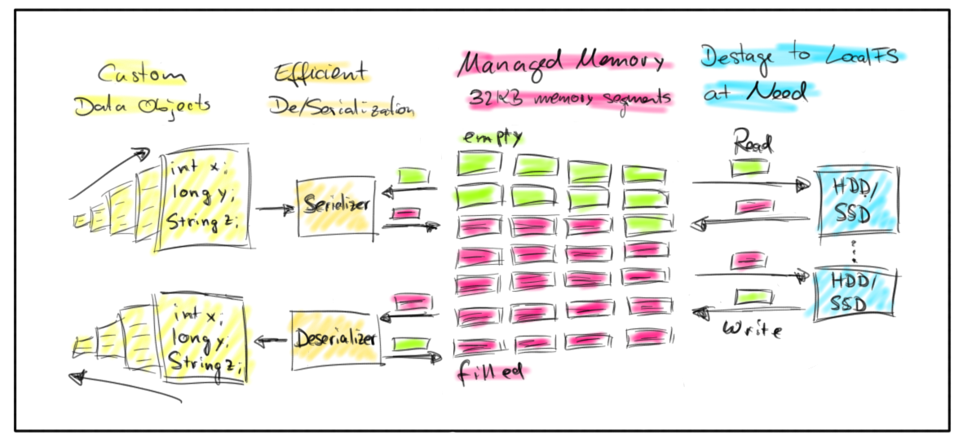
Paged Memory Management

Slide 32
Configuring Flink
Per job
Parallelism
System config
Total JVM heap size (-Xmx)
% of total JVM size for Flink runtime
Memory for network buffers (soon not needed)
That's all you need. System will not throw an OOM exception to you.

Slide 33
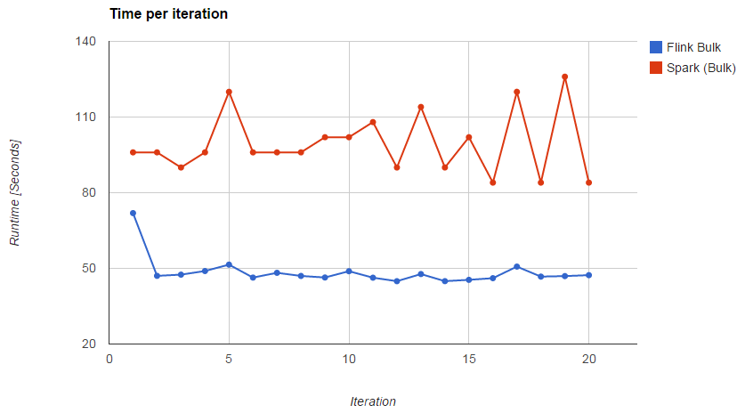
Benefits of managed memory
More reliable and stable performance (less GC effects, easy to go to disk)

Slide 34
Native iterative processing

Slide 35
Example: Transitive Closure
case class Path (from: Long, to: Long)
val env =
ExecutionEnvironment.getExecutionEnvironment
val edges = ...
val tc = edges.iterate (10) { paths: DataSet[Path] =>
val next = paths
.join(edges).where("to").equalTo("from") {
(path, edge) => Path(path.from, edge.to)
}
.union(paths).distinct()
next
}
tc.print()
env.execute()

Slide 36
Iterate natively

Slide 37
Iterate natively with deltas

Slide 38
Effect of delta iterations
# of elements updated
iteration

Slide 39
Iteration performance
MapReduce

Slide 40
Program optimization

Slide 41
A simple program
val orders = …
val lineitems = … val filteredOrders = orders
.filter(o => dataFormat.parse(l.shipDate).after(date))
.filter(o => o.shipPrio > 2)
val lineitemsOfOrders = filteredOrders
.join(lineitems) .where(“orderId”).equalTo(“orderId”)
.apply((o,l) => new SelectedItem(o.orderDate, l.extdPrice)) val priceSums = lineitemsOfOrders
.groupBy(“orderDate”).sum(“l.extdPrice”);

Slide 42
Two execution plans
GroupRed
GroupRed
sort
sort
hash-part [0,1]
Combine
Best plan
depends on
relative sizes of input files
forward
Join
Hybrid Hash
Join
Hybrid Hash
buildHT
probe
buildHT
probe
broadcast
forward
hash-part [0]
hash-part [0]
Map
DataSource
lineitem.tbl
Map
DataSource
lineitem.tbl
Filter
Filter
DataSource
orders.tbl
DataSource
orders.tbl

Slide 43
Examples of optimization
Task chaining
Coalesce map/filter/etc tasks
Join optimizations
Broadcast/partition, build/probe side, hash or sort-merge
Interesting properties
Re-use partitioning and sorting for later operations
Automatic caching
E.g., for iterations

Slide 44
Closing

Slide 45
Flink Roadmap for 2015
Exactly-once streaming with flexible state
Support for Google Dataflow
Batch Machine Learning library
Streaming Machine Learning with SAMOA
Graph library additions (more algorithms)
Interactive programs and Zeppelin
SQL on top of expression language
and more…

Slide 46
Flink community
#unique contributors by git commits
(without manual de-dup)
Notes:
dev list: 300-400 messages/month. record 1000 messages on

Slide 47

flink.apache.org @ApacheFlink

